Slide 1
Machine learning approaches to classifying genetic variants
Jen Johnson

Slide 2
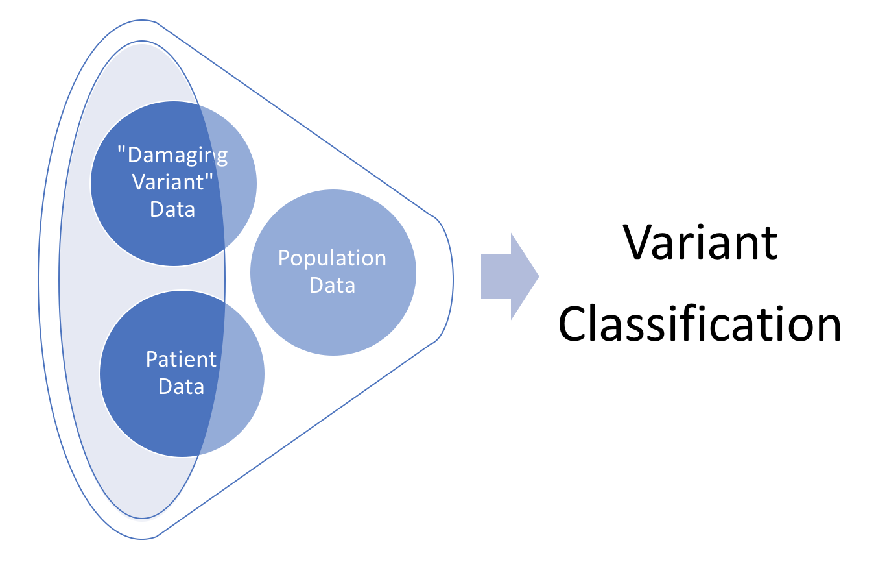
Classifying Genetic Variants
5 Tier-system
Benign
Likely Benign
Unknown
Likely Pathogenic
Pathogenic

Slide 3
Motivation
Classification assists in medical treatment
Pathogenic Variant obligates response
Variant of Unknown Significance is uncertain
Knowledge of disease mechanism → Increased efficiency of drug development

Slide 4
Challenges
4.5 million variants per person to classify
Difficult to experimentally verify pathogenicity
Relationships between genotype and phenotype are complicated
Auton et al., 2015

Slide 5
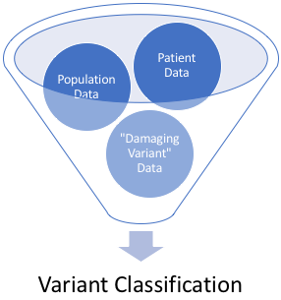
Questions for Determining Pathogenicity
Does the variant alter the function of the gene?
Can the functional change result in a disease or alternative phenotype?
Is the disease or alternative phenotype relevant to the clinical condition present in the individual?
Duzkale et al. 2013

Slide 6
ACMG Guidelines
Professional guidelines for
assigning weights to evidence
combining evidence into a classification
Computational Predictors
Functional Evidence
Richards et al., 2015

Slide 7
Population Data: Allele Frequency
Allele Frequency: a measure of the common-ness of the variant in the population
Because of natural selection, variants present at high frequencies in the population are more likely to be benign than pathogenic.
Low Allele Frequency → More Likely Pathogenic

Slide 8
Example ACMG Rule
Evidence of Pathogenicity | Category
Moderate | PM2 Absent from controls (or at extremely low frequency if recessive) in Exome Sequencing Project, 1000 Genomes Project, or Exome Aggregation Consortium
Richards et al., 2015

Slide 9
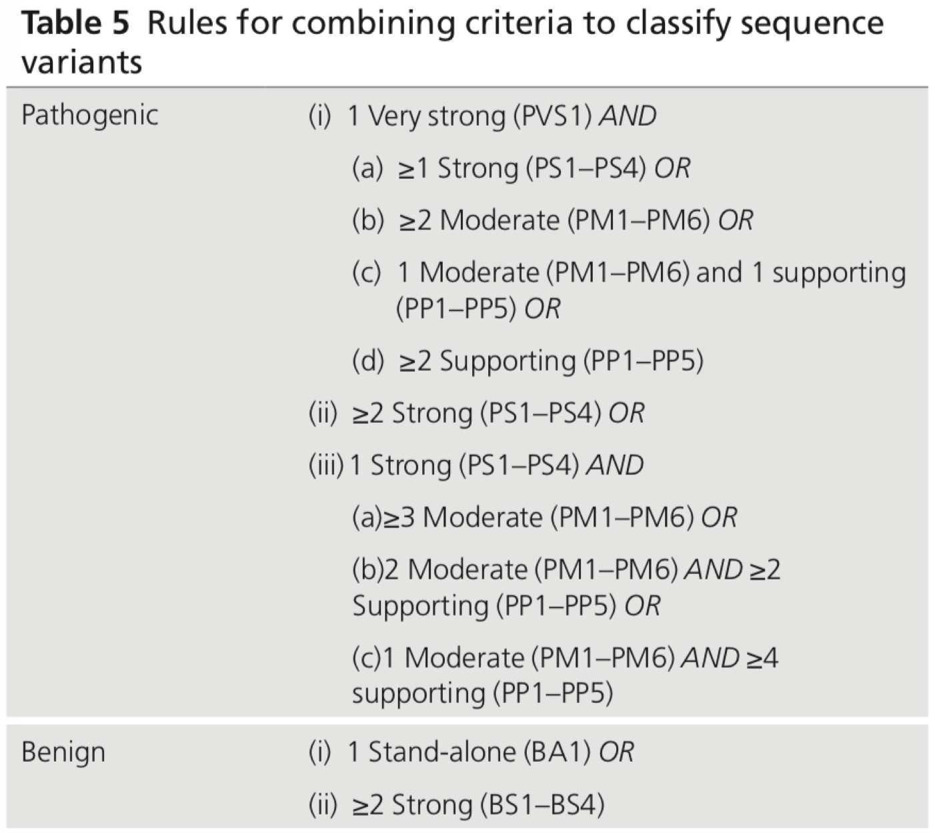
Combining Rules into a Classification
Richards et al., 2015

Slide 10
Limitations of ACMG Guidelines
Flexible wording leads to inconsistencies.
Evidence of Pathogenicity | Category
Moderate | PM2 Absent from controls (or at extremely low frequency if recessive) in Exome Sequencing Project, 1000 Genomes Project, or Exome Aggregation Consortium
Richards et al., 2015

Slide 11
Limitations of ACMG Guidelines
Flexible wording leads to inconsistencies.
Manual methods are inefficient.

Slide 12
Machine Learning Approaches
Training Data
Model
Testing Data
Trained Model
Classification
Variant Classification can be framed as a machine learning problem.

Slide 13
REVEL
Ioannidis et al., 2016
https://medium.com/@williamkoehrsen/random-forest-simple-explanation-377895a60d2d

Slide 14
Limitations of REVEL
Considers Biochemical aka “Damaging Variant” Data
Primarily answers the first question: Does the variant alter the function of the gene?

Slide 15
My Goals: Hybrid Classification
ACMG Guidelines
Address population data in addition to ”damaging variant” data
Retain flexibility and subtlety of differential weighting of different features
Machine Learning
Use a large volume of data to extract trends
Use computational methods to increase efficiency

Slide 16
Probabilistic Soft Logic: Rules
Framework for inferring knowledge from a logic network
Rules for inferring relationships:
Knows(A, B) & Knows(B, C) & (A != C) >> Knows(A, C)
Lives(A, L1) & Lives(B, L1) & (A != B) >> Knows(A, B)
Kimmig et al., 2012

Slide 17
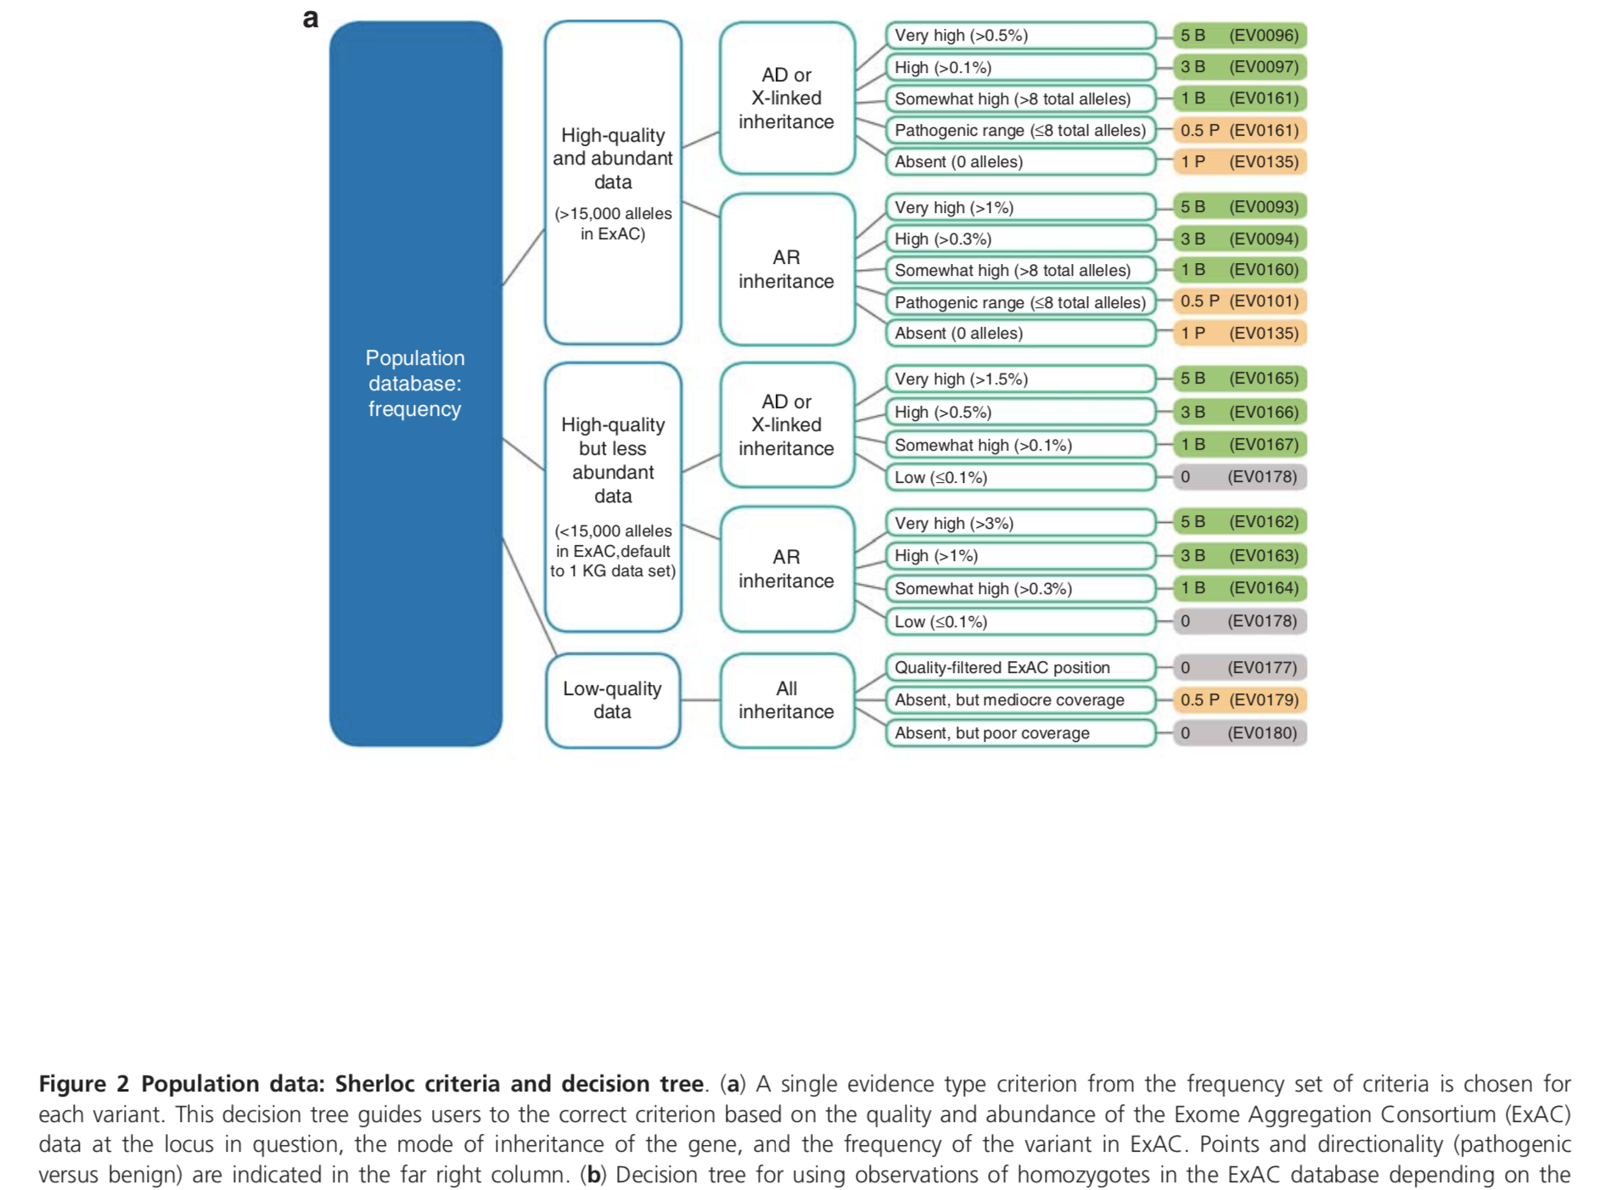
Sherloc
Nykamp et al., 2017

Slide 18
Evidence of Pathogenicity | Category
Moderate | PM2 Absent from controls (or at extremely low frequency if recessive) in Exome Sequencing Project, 1000 Genomes Project, or Exome Aggregation Consortium
Richards et al., 2015
Nykamp et al., 2017

Slide 19
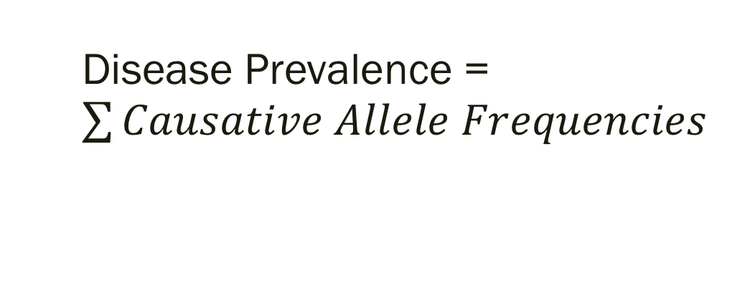
Mode of Inheritance
Recessive variants have a higher allele frequency in the population because only homozygous individuals are acted on by natural selection.
Disease Prevalence = $\sum{Causative Allele Frequencies}$
Variant 2
Disease Prevalence
A a
A
a
AA | Aa
Aa | aa
Variant 1
Disease

Slide 20
Data Quality
An allele frequency observed in a large population provides more confidence in the estimate of allele frequency…
… than an allele frequency observed in a small population.

Slide 21
Hybrid Classification
Evidence of Pathogenicity | Category
Moderate | PM2 Absent from controls (or at extremely low frequency if recessive) in Exome Sequencing Project, 1000 Genomes Project, or Exome Aggregation Consortium
Allele Frequency

Slide 22
PSL Rules
HasCat(V, Benign)
HasCat(V, Pathogenic)
HasCat(A, C) & HasSimilarAF(A, B) & (A != B) >> HasCat(B, C)
HasCat(V, C) & HasSimilarAF(A, B) & (A != B) >> HasCat(B, C)
Variant A has Class C
Variant A has similar Allele Frequency to Variant B
Variant A
is not Variant B
Probability that Variant B has Class C

Slide 23
Rules
HasCat(A, C) & HasSimilarAN(A, B) & (A != B) >> HasCat(B, C)
HasCat(A, C) & HasSimilarAD(A, B) & (A != B) >> HasCat(B, C)
HasCat(A, C) & HasSimilarAF(A, B) & (A != B) >> HasCat(B, C)
Higher Weight → More Important Rule
Hypothesis: AF Rule will have the highest weight.

Slide 24
First Rules and Results
HasCat(A, C) & HasSimilarAN(A, B) & (A != B) >> HasCat(B, C)
HasCat(A, C) & HasSimilarAD(A, B) & (A != B) >> HasCat(B, C)
HasCat(A, C) & HasSimilarAF(A, B) & (A != B) >> HasCat(B, C)
False Positive Rate: 42.8
False Negative Rate: 66.7
Specificity: 57.1
Sensitivity: 33.3
0.047
0.114
1.000
max
HasCat(V, Benign),
HasCat(V, Pathogenic)

Slide 25
Rules (Revised)
HasCat(A, C) & HasSimilarAN(A, B) & (A != B) >> HasCat(B, C)
HasCat(A, C) & HasSimilarAD(A, B) & (A != B) >> HasCat(B, C)
HasCat(A, C) & HasSimilarAF(A, B) & (A != B) >> HasCat(B, C)
HasCat(V, C) (0, 1) → [0, 1]

Slide 26
Rules + Results (Revised)
HasCat(A, C) & HasSimilarAD(A, B) & (A != B) >> HasCat(B, C)
HasCat(A, C) & HasSimilarAF(A, B) & (A != B) >> HasCat(B, C)
Percent Change from previous model
False Positive Rate : 26.7 -37%
False Negative Rate: 40.0 -40%
Specificity: 73.3 + 28%
Sensitivity: 60.0 + 80%
0.027
1.052

Slide 27
Future Work
Extracting weights from Nykamp’s real data from ClinVar
Propagation of uncertainty related to allele frequency categories

Slide 28
Acknowledgements
Professor Linderman
CS Department
Professor Ward and Professor Briggs
Family and Friends

Slide 29
References
Auton, Adam, Gonçalo R. Abecasis, David M. Altshuler, Richard M. Durbin, Gonçalo R. Abecasis, David R. Bentley, Aravinda Chakravarti, et al. 2015. “A Global Reference for Human Genetic Variation.” Nature 526 (7571): 68–74. https://doi.org/10.1038/nature15393.
Ioannidis, Nilah M., Joseph H. Rothstein, Vikas Pejaver, Sumit Middha, Shannon K. McDonnell, Saurabh Baheti, Anthony Musolf, et al. 2016. “REVEL: An Ensemble Method for Predicting the Pathogenicity of Rare Missense Variants.” The American Journal of Human Genetics 99 (4): 877–85. https://doi.org/10.1016/j.ajhg.2016.08.016.
Kimmig, Angelika, Stephen Bach, Matthias Broecheler, Bert Huang, and Lise Getoor. 2012. “A Short Introduction to Probabilistic Soft Logic.” In Proceedings of the NIPS Workshop on Probabilistic Programming: Foundations and Applications, 1–4.
Mahmood, Khalid, Chol-hee Jung, Gayle Philip, Peter Georgeson, Jessica Chung, Bernard J. Pope, and Daniel J. Park. 2017. “Variant Effect Prediction Tools Assessed Using Independent, Functional Assay-Based Datasets: Implications for Discovery and Diagnostics.” Human Genomics 11 (1). https://doi.org/10.1186/s40246-017-0104-8.
Nykamp, Keith, Michael Anderson, Martin Powers, John Garcia, Blanca Herrera, Yuan-Yuan Ho, Yuya Kobayashi, et al. 2017. “Sherloc: A Comprehensive Refinement of the ACMG–AMP Variant Classification Criteria.” Genetics in Medicine 19 (10): 1105–17. https://doi.org/10.1038/gim.2017.37.
Richards, Sue, Nazneen Aziz, Sherri Bale, David Bick, Soma Das, Julie Gastier-Foster, Wayne W. Grody, et al. 2015. “Standards and Guidelines for the Interpretation of Sequence Variants: A Joint Consensus Recommendation of the American College of Medical Genetics and Genomics and the Association for Molecular Pathology.” Genetics in Medicine 17 (5): 405–23. https://doi.org/10.1038/gim.2015.30.

Slide 30
Hybrid Classification
Evidence of Pathogenicity | Category
Moderate | PM2 Absent from controls (or at extremely low frequency if recessive) in Exome Sequencing Project, 1000 Genomes Project, or Exome Aggregation Consortium
Allele Frequency

